Slide 1
Online Grievance Redressal System
Submitted By:
Rubyat jesmin Shammi
UG02-47-18-034
Tasnova Tasnim
UG02-47-18-012
Submitted To:
Muhammad Masud Tarek Head Of The Department CSE
State University Of Bangladesh

Slide 2

INTRODUCTION
Grievance Redressal System is an online platform to receive and act on complaints reported by students of private or public institutions, enabling prompt actions on any issue raised by them and to avail services more effectively.

Slide 3

Why is grievance redressal system necessary?
Grievance redressal is necessary in all organizations to investigate reason for the dissatisfaction of student and to obtain a speedy resolution to the problem. It also ensures that the grievances are resolved promptly and impartially with complete confidentiality.

Slide 4

How does the grievance and redressal system work?
Redressal System- The grievance redressal system is a machinery to sort out the problems faced by students, parents, teachers and other non-teaching staff in any institution or organization .The grievance redressal mechanism includes procedures for recording, registering, and sorting grievances.

Slide 5
Advantages of Grievance Redressal System
Provides security for affected person to participate without fear of intimidation or retribution
It provides a fair and speedy means of grievance handling.
Shows clarity in procedures, processes, and time frames adopted
The affected person need not consult grievance cell members directly to register complaints
Saves time of affected person and cell members
Automates entire grievance procedure right from its registration to closure
Greater confidentiality and transparency in complaints dealing procedure

Slide 6

System Requirements User Interface
The system will be a web based system.
The system is well visualized.
Users can easily access to this system using Internet connection.
Using Mozilla Firefox, Google Chrome, Opera Mini, Safari
and Internet Explorer- a user can browse the system.

Slide 7

Implementation and UI
There are three types of users for the “Grievance Redressal System”. Different types of user have different user interfaces and functionalities and scope in the GR system. Three types of users are:
Admin
1.Dept
2.Proctor
3.GRC(Grievance Redressal Committee)
Student

Slide 8
Software requirements
Back End
PHP
MySQL
Front End
HTML
CSS
Bootstrap
Jquery
Javascript

Slide 9
Work schedule:
Name | Weekly Working hour
Rubyat Jesmin Shammi | 14/16
Tasnova Tasnim | 14/16

Slide 10
Project Cost
Per hour charge 250/-
728(hour)*250 = 182,000/-
Server Cost 2,000/-
Domain Cost 1,000/-
Total Cost = 185,000 /-

Slide 11
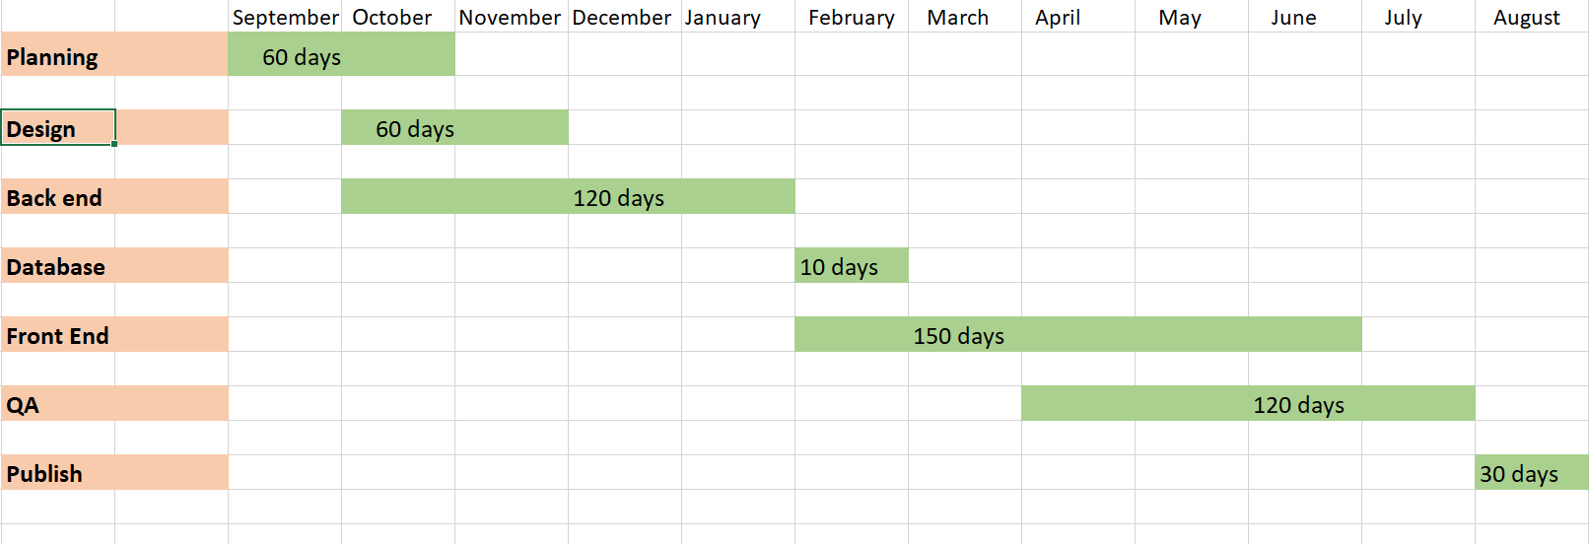
Grievance redressal system Gantt chart

Slide 12

Conclusion
This project work address Grievance Redressal System in State University of Bangladesh, Dhaka. The system has the benefits of easy access because it will be developed as a platform independent web application, so the admin can maintain a proper contact with their users, which may be access anywhere.

Slide 13


